Slide 1
Computer Basics 1
Computer Basic 1 includes two lessons:
Lesson 1: Introduction to Computers
Lesson 2: Common Computer Terminology

Slide 2
Lesson 1 – Introduction to Computer
Objectives
After completing lesson 1, you will be able to:
Describe the importance of computers in today’s world.
Identify the main parts of a computer.
Identify the steps for starting a computer.
Identify the different groups of keys on a keyboard.
Perform different tasks by using a mouse.
Notes:
A computer is an electronic device used to store and process information. It plays a major role in our lives. You use computers in education and research. You also use them for broadcasting news, receiving and sending messages to family and friends, making presentations, maintaining official and personal records, making weather forecasts, and for various other business and recreation activities. By using computers, you save a lot of time, effort, and money.
After completing lesson 1, you will be able to:
Describe the importance of computers in today’s world.
Identify the main parts of a computer.
Identify the steps for starting a computer.
Identify the different groups of keys on a keyboard.
Perform different tasks by using a mouse.

Slide 3
OBJECTIVES
Learn Basic Computer Terminology
Difference Between Hardware and Software
Understanding Computer Components
Basic Keyboard and Mouse Usage
Proper Care For your PC

Slide 4
DEFINITION
What is a Computer?
com·put·er Pronunciation key (km-pytr)
n.
A device that computes, especially a programmable electronic machine that performs high-speed mathematical or logical operations or that assembles, stores, correlates, or otherwise processes information.
One who computes.
(American Heritage Dictionary, 4th ed. Pub. 2000)

Slide 5
The Role of Computers
In Business and Industry
In Publication Field
In Education Field
In Government Organizations
In Medical Field
In Science Field
In Entertainment Field
Notes:
Computers play a major role in our daily lives. They are used in industries, schools, government offices, and shops. You can use computers to communicate with your family and friends, create a household budget, book travel and movie tickets, or manage your business.
In business and industry, you use computers to maintain accounts, create personnel records, track inventory, prepare presentations and reports, manage projects, and communicate by e-mail.
You can use computers to design any type of publication ranging from simple newsletters to fashion magazines, marketing materials, books, or newspapers.
In the field of education, trainers can use computers to deliver training through audio-visual learning aids, maintain student records to track performance, search for information on different topics, and create or submit assignments.
In government organizations, you use computers to organize information by storing and updating records. Computers are also used for providing services to citizens. For example, you can view information on current policies and government issues on a computer.
In the field of medicine, doctors use computers to review medical records of patients. Doctors also use computers to find information about the latest drugs available to treat a disease. Doctors can also use computer technology to discuss and share information about various diseases.
You can use computers to view the details of your bank account. Traders use computer technology to get instant information on stock markets, to trade stocks, and to manage investments.
Scientists use computers for scientific research, and to gather and analyze information. For example, they use computers to view images from space and to publish information on their recent research.
You can also use computers to create drawings and paintings. Photographers use computers to edit and enhance pictures. Writers use computers to write content for their books and to also create illustrations. By using computers, writers can make changes in the content easily and save a lot of time.
In the field of entertainment, you can use computers to listen to music, watch movies, store and print photographs, send greetings, and play games.

Slide 6

Uses for a PC
Word Processing
Desktop Publishing
Database Management
Spreadsheets
Communication
Finance
Education
Entertainment
News and Information
Doorstop

Slide 7
Tips for Beginners
Explore Your Computer
Mistakes won’t Kill You
EDIT/ UNDO is your Friend
Be persistent
Apply what you Learn
Don’t try to learn too fast
Walk away if you get frustrated
Have Fun

Slide 8
Why Learn This Stuff?
Calculations
Letters, emails, notes
Be able to talk to Friends & family
It’s Fun

Slide 9
THIS IS A FEW OF THE
DIFFERENT TYPES of
COMPUTERS
•
Desk top
computer
computer
Lap Top
Hand Held
Computer
computer

Slide 10
DEFINITION
Hardware Vs. Software
If you can touch it, it’s hardware

Slide 11


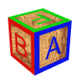


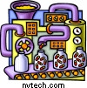
















Examples of Hardware

Slide 12

The Programs that are on the disks are software

Slide 13
Parts of a Computer
Input Devices (Keyboard, Mouse, etc.)
Output Devices (Monitor, Speakers, etc.)
Central Processing Unit (CPU) and memory
Motherboard (Circuit Board)
Expansion Cards (Video Card, Sound Card, or NIC)
Hard Drive Ports and Connections (USB, Firewire, etc.)

Slide 14
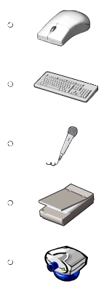
Parts of a Computer
Input Devices
Mouse
Keyboard
Microphone
Scanner
Webcam
Notes:
Mouse: A device that you use to interact with items displayed on the computer screen. A standard mouse has a left and a right button. You use the left button to select items and provide instructions by clicking an active area on the screen. You use the right button to display commonly used menu items on the screen.
Keyboard: A set of keys that resembles a typewriter keyboard. You use the keyboard to type text, such as letters or numbers into the computer.
Microphone: A device that you can use to talk to people in different parts of the world. You can record sound into the computer by using a microphone. You can also use a microphone to record your speech and let the computer convert it into text.
Scanner: A device that is similar to a photocopy machine. You can use this device to transfer an exact copy of a photograph or document into a computer. A scanner reads the page and translates it into a digital format, which a computer can read. For example, you can scan photographs of your family using a scanner.
Webcam: A device that is similar to a video camera. It allows you to capture and send the live pictures to the other user. For example, a webcam allows your friends and family to see you when communicating with them.

Slide 15



Parts of a Computer
Output Devices
Monitor
Printer
Speaker/Headphone
Notes:
You use output devices to get feedback from a computer after it performs a task. Some examples of output devices are described in the following list.
Monitor: A device that is similar to a television. It is used to display information, such as text and graphics, on the computer.
Printer: A device that you use to transfer text and images from a computer to a paper or to another medium, such as a transparency film. You can use a printer to create a paper copy of whatever you see on your monitor.
Speaker/Headphone: Devices that allow you to hear sounds. Speakers may either be external or built into the computer.

Slide 16
Parts of a Computer
Central Processing Unit (CPU)
A device that interprets and runs the commands that you give to the computer.
Also referred to as the processor.
Two major brands are Intel and AMD.
Examples: Intel Core 2 Duo, AMD Turion X2
Notes:
The central processing unit (CPU) is a device that interprets and runs the commands that you give to the computer. It is the control unit of a computer. The CPU is also referred to as the processor.

Slide 17
Parts of a Computer
Memory
Memory is where information is stored and retrieved by the CPU.
There are two main types of memory:
  Random Access Memory (RAM): It is the main memory and allows you to temporarily store commands and data.
  Read Only Memory (ROM): It is the memory that retains its contents even after the computer is turned off.
Notes:
Memory is where information is stored and retrieved by the CPU. There are two main types of memory.
Random Access Memory (RAM): It is the main memory and allows you to temporarily store commands and data. The CPU reads data and commands from RAM to perform specific tasks. RAM is volatile, which means it is available only while the computer is turned on. The contents of RAM must be copied to a storage device if you want to save the data in the RAM.
Read Only Memory (ROM): It is the memory that retains its contents even after the computer is turned off. ROM is nonvolatile, or permanent, memory that is commonly used to store commands, such as the commands that check whether everything is working properly.

Slide 18

RAM VERSUS HARD DRIVE
If we use the analogy of a desk: Then the work we are doing on the desk top would be using the RAM and the work we store in the file drawers would be on the HARD DRIVE.

Slide 19
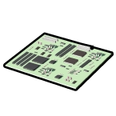
Parts of a Computer
Motherboard
Is the main circuit board inside the computer.
Has tiny electronic circuits and other components on it.
Connects input, output, and processing devices together (CPU, Memory, Hard Drive, DVD Drive)
Tells the CPU how to run.
Notes:
The motherboard is the main circuit board inside the computer. It has tiny electronic circuits and other components on it. A motherboard connects input, output, and processing devices together and tells the CPU how to run. Other components on the motherboard include the video card, the sound card, and the circuits that allow the computer to communicate with devices like the printer. The motherboard is sometimes called a system board.

Slide 20


Parts of a Computer
Expansion Cards
Video Card – is connected to the computer monitor and is used to display information on the monitor.
Network Interface Card (NIC) – is connected to other computers so that information can be exchanged between them.
Sound Card– converts audio signals (microphone or audio tape) which can be stored as a computer audio file.
Notes:
An expansion card is a circuit board that can be attached to the motherboard to add features such as video display and audio capability to your computer. An expansion card either improves the performance of your computer or enhances its features. Expansion cards are also called expansion boards. Some types of expansion cards are described in the following list.
Video Card: It is connected to the computer monitor and is used to display information on the monitor.
Network Interface Card (NIC): It allows the computer to be connected to other computers so that information can be exchanged between them.
Sound Card: It converts audio signals from a microphone, audio tape, or some other source to digital signals, which can be stored as a computer audio file. Sound cards also convert computer audio files to electrical signals, which you can play through a speaker or a headphone. The microphone and the speakers or the headphones connect to the sound card.

Slide 21

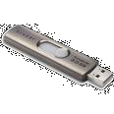


Parts of a Computer
Storage Devices
Hard Disk
Flash Drive
CD-ROM
DVD-ROM
Notes:
You use storage devices to store computer information. Storage devices come in many forms. Some examples are hard drive or disk, CD-ROM, floppy disk, and DVD-ROM. Storage devices can be divided into two types, internal storage devices and external storage devices. Some common storage devices are described in the following list.
Hard Disk: A magnetic disk that is usually the main storage device on most computers. It can be an external or an internal device.
Floppy Disk: A portable storage device that allows you to store a small amount of data. A disadvantage of this disk is that it can be easily damaged by heat, dust, or magnetic fields.
CD-ROM: A portable storage medium that allows you to store 400 times more data than on a floppy disk. It is less prone to damage than a floppy disk.
DVD-ROM: A portable storage medium that is similar to a CD-ROM; however, it can store larger amounts of data than a floppy disk or a CD-ROM. A DVD-ROM is commonly used to store movies and videos.

Slide 22
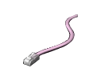
Parts of a Computer
Ports and Connections
Universal Serial Bus (USB) Port
FireWire (similar to USB but faster)
Network Port (Ethernet)
Parallel Port and Serial Port
Display Adapter
Power
Notes:
A port is a channel through which data is transferred between input/output devices and the processor. There are several types of ports that you can use to connect the computer to external devices and networks. Some types of ports are described in the following list.
Universal Serial Bus (USB) Port: You use this to connect peripheral devices such as a mouse, a modem, a keyboard, or a printer to a computer.
FireWire: You use this to connect devices such as a digital camera. It is faster than the USB.
Network Port: You use this to connect a computer to other computers to exchange information between the computers.
Parallel Port and Serial Port: You use these ports to connect printers and other devices to a personal computer. However, the USB is now the preferred method for connecting peripheral devices because it is faster and easier to use.
Display Adapter: You connect a monitor to the display adapter on your computer. The display adapter generates the video signal received from the computer, and sends it to a monitor through a cable. The display adapter may be on the motherboard, or on an expansion card.
Power: The motherboard and other components inside a computer use direct current (DC). A power supply takes the alternating current (AC) from the wall outlet and converts it into DC power.

Slide 23
Using a Computer
To turn on a computer, press the power button on the system unit.
Log on to the operating system by your user name and password.
Computers allow you to create, modify, and save files.
To shut down a computer, click Start, and then, at the bottom of the Start menu, click Shut Down.
Notes:
To turn on a computer, press the power button on the system unit. When you turn on the computer, lights on the keyboard may blink briefly and you may also hear a beep. This is an indication that the power-on self test (POST) has started.
The computer performs a sequence of quick tests to check whether the motherboard, memory, hard drive, and other components are working.
If you hear a series of beeps, the monitor may display a message indicating that a component is not functioning. For example, if the keyboard cable is not attached, an error message may report that there is no keyboard detected.
After POST, the computer starts the operating system, and then displays the logon screen. You now log on to the Microsoft® Windows® XP operating system. The operating system allows you to instruct the computer what to do after you have turned it on.
The operating system controls the computer’s hardware and also manages the computer’s operations and tasks, such as logging on, logging off, and shutting down.
For example, to log on to Windows XP, you need to type your user name and password. The settings for the user account are applied and you are now logged on to Windows XP. After you log on, you can perform various tasks, such as creating a new file or modifying an existing file.
After performing the required tasks, you need to save the changes you made to the file. You can then log off from Windows XP. To log off, you need to click Start, and then click Log Off.
To securely turn off your computer, you must shut down Windows XP. To do this, you need to click Start, and then, at the bottom of the Start menu, click Shut Down. You can end your Windows XP session by clicking the Shut Down Windows dialog box.
If you encounter problems while using the computer, you can choose the Restart option to restart the computer. To do this, click Restart in the Shut Down Windows dialog box.
On most computers, you should never use the actual power button on the front of the system unit to turn off the computer unless it stops responding.

Slide 24
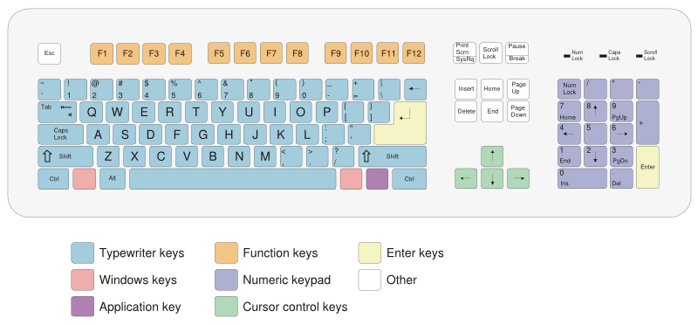
Using a Keyboard
Notes:
Alphanumeric Keys: These keys are used for entering letters and numbers.
Special Keys: Keys such as Control (CTRL), SHIFT, SPACEBAR, ALT, CAPS LOCK, and TAB are special keys. These special keys perform special functions depending on when and where they are used.
Punctuation Keys: Punctuation keys include keys for punctuation marks, such as colon (:), semicolon (;), question mark (?), single quotation marks (‘ ’), and double quotation marks (“ ”).
Command Keys: Keys such as INSERT (INS), DELETE (DEL), and BACKSPACE are command keys. You use these keys to insert and delete text and objects. You can turn the INSERT key either ON or OFF. When turned ON, the INSERT key helps you overwrite characters to the right of the insertion point. When turned OFF, the INSERT key helps you enter text or characters to the right of the insertion point, without overwriting this text or characters. An insertion point is the blinking vertical line that indicates the location at which the inserted text appears. The DELETE key is used to remove typed text, characters, and other objects on the right side of the insertion point. The BACKSPACE key is used to remove typed text, characters, and other objects on the left side of the insertion point.

Slide 25
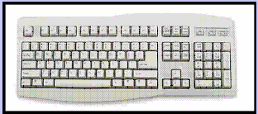
KEYBOARD
The Keyboard
(This is the primary input device)

Slide 26
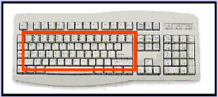
KEYBOARD
Alphanumeric Keys

Slide 27
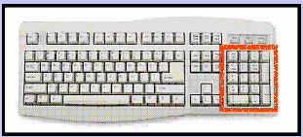
KEYBOARD
Numeric Keypad

Slide 28
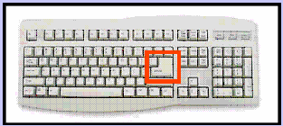
KEYBOARD
Enter (Return) Key

Slide 29
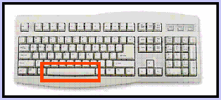
KEYBOARD
Spacebar

Slide 30
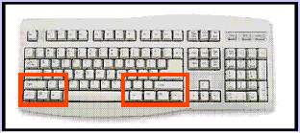
KEYBOARD
“Modifier” keys: CTRL, ALT, SHIFT

Slide 31
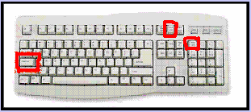
KEYBOARD
“State “ keys: Caps, Scroll, Numlock

Slide 32
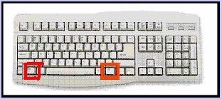
KEYBOARD
Windows keys

Slide 33
Using a Mouse
A mouse is a small device that you can use to move, select, and open items displayed on your monitor.
Most mouse devices have at least two buttons, left and right.
Mouse’s action:
  Point
  Double Click
  Left Click
  Right Click
  Click-and-Drag or Drag-and-Drop
Notes:
A mouse is a small device that you can use to move, select, and open items displayed on your monitor.
The mouse is usually kept on the desk next to the keyboard. Most mouse devices have at least two buttons, left and right. Most of the actions are performed by clicking the left button.
The right button is used for specific functions. Some advanced types of mouse devices provide additional buttons to speed up common tasks, such as scrolling text.
As you move the mouse on your desk, a pointer moves correspondingly on your screen. The mouse allows you to select an item on the screen.
As you move the pointer over different areas of the screen, the items or the pointer change. These changes indicate that you can click an item to open it, or see more of its options.
You can open an item by moving the pointer to it, and clicking the left mouse button twice.
In a document, you can use the mouse to select a position to start typing.
You need to position the pointer in the document, click where you want to insert text, and then use your keyboard to begin typing.
To move an item, you need to click it, and then holding the mouse button down, move the item to a different location. After you move the item to the new location, you release the mouse button.
The right button on the mouse is used to display a menu. The options on this menu include the most common tasks, such as copying text from one location and pasting it to another location. These are called context-sensitive menus. These menus help you complete tasks quickly.
Most mouse devices also have a wheel that help you to scroll through documents or pages.
To scroll, place your finger on the wheel and roll it back and forth. This moves the document up and down.

Slide 34
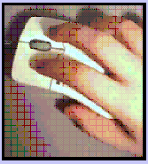

MOUSE
Holding the mouse
Grip between thumb and ring finger
(Right handed grip shown, Lefties use other hand)

Slide 35

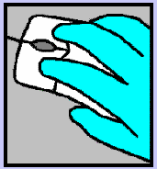
MOUSE
Mouse Pointer

Slide 36
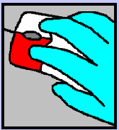

MOUSE
Left Clicking

Slide 37
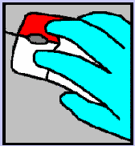

MOUSE
Right clicking

Slide 38
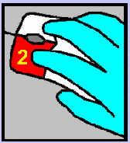

MOUSE
Double clicking
(Use the left side,
Click twice)

Slide 39
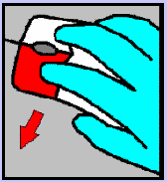

MOUSE
Click and drag

Slide 40
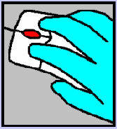

MOUSE
Scroll wheel and optional buttons

Slide 41
Questions

Slide 42
Lesson 2 – Common Computer Terminology
Objectives
Identify the primary hardware components of a computer.
Define an operating system and its role.
Define the term program.
Explain what is meant by data.
Define the term network, and identify the benefits of networking.
Define the term Internet.

Slide 43
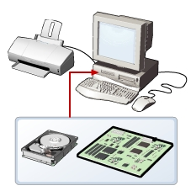
Hardware
Refers to all the physical components of a computer.
Includes all input devices, processing devices, storage devices, and output devices.
Examples of hardware are:
  keyboard
  mouse
  motherboard
  monitor
  hard disk
  cables
  printer
Notes:
Hardware refers to all the physical components of a computer. It includes all input devices, processing devices, storage devices, and output devices. The keyboard, mouse, motherboard, monitor, hard disk, cables, and printer are all examples of hardware.
You use hardware to provide input to a computer and also to get the desired output. For example, when you play a musical instrument, such as a piano, you provide input by pressing the keys and get the desired output in the form of music. Similarly, computers also need input and output devices to perform tasks.
You use a keyboard and a mouse to provide input and to select and run programs. You can view the output on a monitor that is similar to a television set, or use the printer to view the output on paper.
Apart from input and output devices, a computer uses processing devices to work on the input data and generate the desired output. The most important processing device is the CPU. The CPU is the brain of the computer. It processes the input to perform calculations and produce output.
A motherboard is a large circuit board that connects input, output, and processing devices. The motherboard circuits provide pathways that allow data to pass through these various components. It also contains chips that determine how, when, and where data can flow through the computer.
Depending on the task that you want your computer to perform, you can choose the appropriate hardware. For example, you can use a NIC to connect your computer to other computers. You can also use expansion cards, such as video cards, to add new features or enhance the performance of your computer. All of these devices are plugged into the motherboard.

Slide 44
Operating Systems
Is the most important software on the computer
Controls and manages the hardware connected to your computer
Provides an interface that helps you to interact with the computer
Ensures that your computer is functioning properly
Windows XP is an example of the operation system.
Can be either text-based or graphics-based.
Graphics-based operating system help you install hardware or software with easy-to-use interface.
Notes:
In addition to hardware, a computer needs software to function. Software sends instructions to the hardware to perform the necessary tasks.
The most important software on the computer is the operating system, which controls and manages the hardware connected to your computer. The operating system provides an interface that helps you to interact with the computer. An example of one of the latest operating systems is Windows XP.
A user interface can be either text-based or graphics-based. Most operating systems provide a graphical user interface (GUI), which displays images and pictures that allow you to interact with a computer easily.
An operating system with a GUI provides an easy-to-use interface to help you install hardware or software. For example, Windows XP provides a setup wizard, which guides the user through each step of a particular task, such installing hardware or software.
An operating system ensures that your computer is functioning properly. You need to update your operating system regularly to ensure that it is compatible with any new hardware that you install.

Slide 45
Programs
The hardware and the operating system together are referred to as a platform.
Programs, also called applications, use this platform to perform tasks.
There are many types of programs:
  Some programs allow you to perform tasks such as writing letters, doing calculations, or sending e-mail messages.
  Other programs allow you to create illustrations, play games, watch movies, or communicate with other computer users.
Notes:
The hardware and the operating system together are referred to as a platform. Programs, also called applications, use this platform to perform tasks. There are many types of programs. Some programs allow you to perform tasks such as writing letters, doing calculations, or sending e-mail messages. For example, a word processor, such as Microsoft® Office Word 2003, is a program that helps you create a letter.
Other programs allow you to create illustrations, play games, watch movies, or communicate with other computer users.

Slide 46
Data
Programs process data that you provide as input to your computer.
Data can be in the form of text, graphics, audio, or video depending on the type of program.
Program processes the data and displays the output on the screen.
You can save this output in a file.
The file can be an audio file, a text file, a graphics file, or a video file.
Notes:
Programs process data that you provide as input to your computer. This data can be in the form of text, graphics, audio, or video depending on the type of program. For example, Calculator is a program that requires input in the form of numbers. Similarly, Sound Recorder is a program that requires input in the form of audio.
When the program receives the data, it processes the data and displays the output on the screen. You can save this output in a file. Depending on the type of data that a file contains, the file is classified as an audio file, a text file, a graphics file, or a video file.

Slide 47
Networks
Is a group of computers and associated devices that are linked together to facilitate sharing information.
Can also be used to share data and devices such as printers.
A typical network has the following three components:
  Server
  Workstation
  Communication channel
Notes:
Consider a scenario where an organization has 10 employees. These employees use computers to perform daily tasks. They also need print data frequently. Instead of giving each employee a printer, which would be expensive, all computers can be connected to a single printer.
You can connect your computer to other computers to share information and hardware components. A group of computers and associated devices that are linked together to facilitate sharing information is called a network. Networks can also be used to share data and devices such as printers.
A network offers many advantages for the computer connected to it. In addition to sharing hardware and software, you can share files and communicate with other computer users on the network. A typical network has the following three components:
Server: The main computer on a network that provides services to other computers on the network. A server decides which computers are allowed to access the hardware and software on the network.
Workstation: A computer connected to a network. You use a workstation to access the hardware and software on a network.
Communication channel: A path or link that connects computers or peripheral devices, such as printers and disk drives, to transfer information. Cables are commonly used as communication channels in a network, but networks can also transfer information through wireless connections.
A network expands as more workstations and servers are connected to it. Depending upon the area covered, a network can be categorized as a local area network (LAN) or a wide area network (WAN).

Slide 48
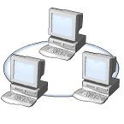
Networks
LAN
Connects devices within a limited area (home or a small group of offices)
Commonly includes computers and shared resources (printers and scanners)
Notes:
A LAN connects devices within a limited area, such as a home or a small group of offices. It commonly includes computers and shared resources such as printers and scanners.

Slide 49
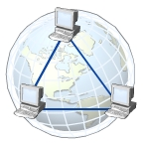
Networks
WAN
Is a network that connects devices in geographically separated areas.
Is used to connect networks across different countries.
The Internet is an example of a WAN.
Notes:
A WAN is a network that connects devices in geographically separated areas. You can use the resources of a WAN to connect two or more LANs by using long wires, optical cables, and satellites. Many organizations use a WAN to connect their networks across different countries. The Internet is an example of a WAN.

Slide 50
Internet
Internet is a worldwide collection of public networks that are linked to each other for information exchange.
Internet offers a range of services to its users (file transfers between Internet users and electronic mail)
The World Wide Web (WWW), or the Web, is another service that the Internet provides.
An intranet is similar to the Web but is accessible only to authorized users of the organization.
Notes:
The Internet is a worldwide collection of public networks that are linked to each other for information exchange. The Internet started as a network to facilitate communication between government and educational departments in the United States.
When other networks were connected to this network, it became a vast medium for exchanging information and ideas.
Today, the Internet connects many commercial, government, and educational networks, as well as individual computers, which share data.
The Internet offers a range of services to its users, such as file transfers between Internet users and electronic mail for sending messages.
The World Wide Web (WWW), or the Web, is another service that the Internet provides. The Web includes specially formatted documents that are interlinked and stored on servers around the world.
You can use the Internet and its services to send messages to other Internet users, search and apply for jobs, watch movies, and buy and sell products.
Many organizations use a special type of network to communicate and share information within the organization. Such a network is called an intranet.
An intranet is similar to the Web but is accessible only to authorized users of the organization.
An intranet is much smaller than the Internet and can provide services such as document distribution, software distribution, access to databases, and training.

Slide 51
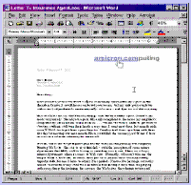
APPLICATIONS
MS Word
(Your basic Word Processor)

Slide 52
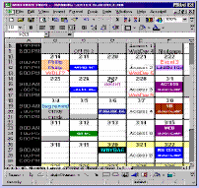
APPLICATIONS
MS Excel
Your basic Spread Sheet)

Slide 53
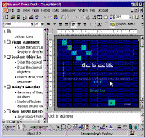
APPLICATIONS
MS Power Point
(For sales presentations)

Slide 54
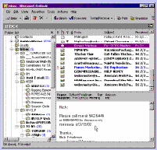
APPLICATIONS
MS Outlook
(Your desktop Personal Information Manager, (PIM))

Slide 55
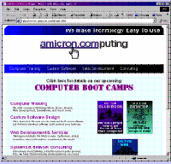
APPLICATIONS
MS Internet Explorer
(Your internet Browser)

Slide 56
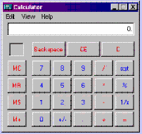
APPLICATIONS
Windows Calculator
(Your basic calculator, also available is a scientific calculator)

Slide 57
APPLICATIONS
WordPerfect Adobe Acrobat
Lotus 1-2-3 Photoshop
QuickBooks Notepad
CorelDraw WinZip
HyperCam Media Player
Photo Paint StarCraft
ETC. ETC.ETC. ETC. Ad Infinitum

Slide 58
Questions

Slide 59
Practices
Practice typing by visiting www.powertyping.com
Practice using the mouse at www.mouseprogram.com

